Slide 1


Capstone Project Phase B - 24-1-D16
David Asulin
Gal Danenberg
Supervisor: Alex Keselman

Slide 2

Introduction
In today's world, getting healthcare guidance often feels like a time-burden. Waiting on hold for ages or spending hours at a clinic just to ask a quick question can be frustrating.

Slide 3
Project Goals
Provide an accessible and affordable healthcare solution.
Encourage people to take care of their health.
Simplify the process of getting health consultation.
Provide users with wide variety of medical knowledge.

Slide 4




The Problem
There are many challenges today within the healthcare department, whether its through traditional face-to-face appointments or online platforms such as messaging or using phone services for consultation, today we will explore some of those obstacles and show our solution.
Long Wait Times
Patients often face long wait times for appointments and consultations.
Limited Access
Physical presence required for many healthcare services.
Phone Consultations
Long wait times for phone services and health advice.

Slide 5
Limited Access and Complexity
1
Physical Presence Required
2
Complex Scheduling
3
Phone Service
Complex appointment scheduling and long wait times exacerbate access issues.
Phone services such as consultant or health advices are given by a non-professional.
Traditional healthcare consultations require physical presence, which can be challenging for those with mobility issues or in remote locations.

Slide 6
Cost Barriers
Subscription Models
User Interface Challenges
Many existing online consultation platforms require subscriptions or payment per consultation, which can be prohibitive for individuals needing only occasional advice.
User interfaces are often not intuitive, reducing accessibility for those with limited technical skills or disabilities.

Slide 7

Unequal Access to Healthcare
There are big differences in how easily people can get medical advice, depending on where they live and their financial situation.
For example :
1
United States Healthcare
2
Rural Healthcare Access
In the United States, healthcare is often not free, and individuals may need insurance coverage or significant financial resources to access medical advice.
Village areas may have limited access to healthcare facilities and specialists, making it harder for residents to receive timely medical advice

Slide 8




The Solution - MediChat
A free AI health consultant chatting platform. This platform will make seeking medical advice and diagnoses easier, helping to lighten the load on healthcare providers and reduce unnecessary visits to medical facilities, and make the process less of a burden.
AI Chatbot
Medical Advice
Free of charge
Intelligent health consultation
Easy access to health information
A free platform that everyone can use

Slide 9
Advantages of MediChat
1
No Wait Time
2
Cost-Free
No need to wait for an appointment
Free of charge
3
User-Friendly
4
Universal Access
Simple and easy to use
Can be used on every device that has access to the internet

Slide 10
Development procedure
1
Planning
Define project scope and requirements
2
Design
Create system architecture and user interface
3
Implementation
Develop the AI chatbot and integrate with healthcare databases
4
Testing
Conduct thorough testing and quality assurance
5
Deployment
Launch MediChat and monitor performance
6
Maintenance
Regular updates and improvements

Slide 11
Technologies
Notes:
Hi everyone my name is David and I am going to talk about the technology stack of our project.

Slide 12

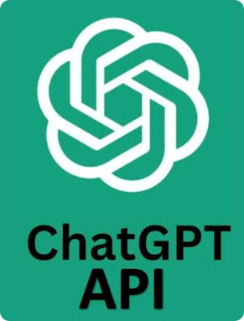
ChatGPT API
The ChatGPT API is a tool that developers can use to add conversation abilities to apps and services. It's powered by advanced artificial intelligence, allowing it to understand and respond to text inputs in a way that feels natural and human-like.
Notes:
The main component of our project is the ChatGPT API, which sends user messages to a specialized model. This model gathers important user details and chat context from the request. To improve the accuracy of the responses, we use a middleware layer that refines the request and simplifies the responses, making them clearer for users.

Slide 13
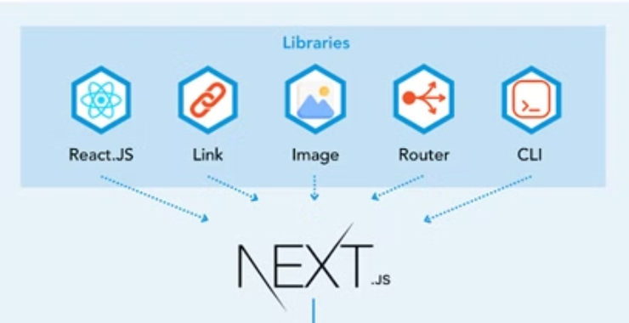
Next.js - MongoDB Architecture
MongoDB
Next.js
React
Node.js
A NoSQL database used for storing and managing data.
A React framework for building server-side rendered applications.
A JavaScript library for building user interfaces.
A JavaScript runtime environment for building server-side applications.
Notes:
For our development, we used Next.js and MongoDB. We chose Next.js for its built-in server capabilities, which simplifies both the backend and deployment processes. MongoDB was selected as our database due to its flexibility and easy integration. For the front end, we implemented it with React, along with Node.js as our package manager.

Slide 14

Vercel
Vercel deployment provides an easy way to host web applications, giving developers a seamless experience from code to production. This cloud platform uses its global edge network to ensure static content delivery and optimal performance.
Notes:
We chose Vercel for our project deployment because of its hosting capabilities for our Next.js application, Vercel provided us easy and accessible way for version control and also provided us a custom domain where our website is hosted

Slide 15
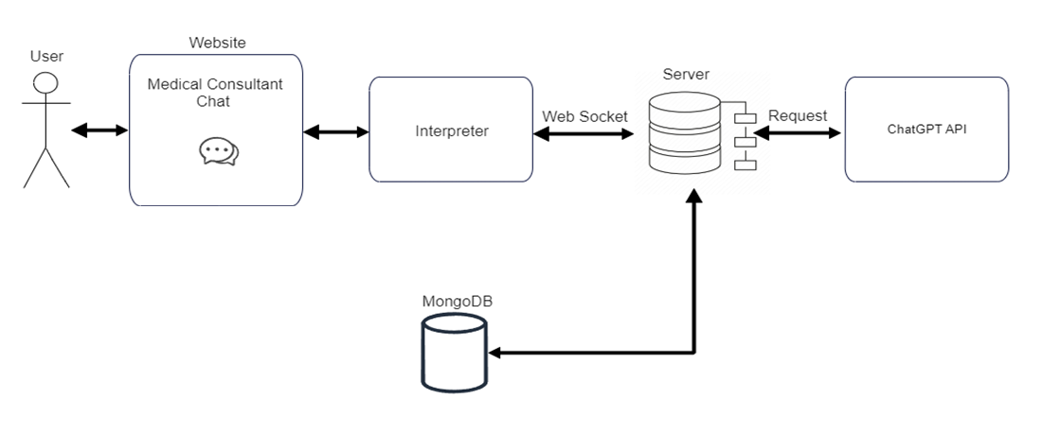
Architecture
Notes:
This is a brief view of our architecture, You can see the user interacts with the Chat AI which then is sent to the interpreter to improve the request before sending it to the handler in the backend which then will also add the data to our database and send the request to chatgpt, same way for the response we handle it and simplify it before returning it back to the user.

Slide 16
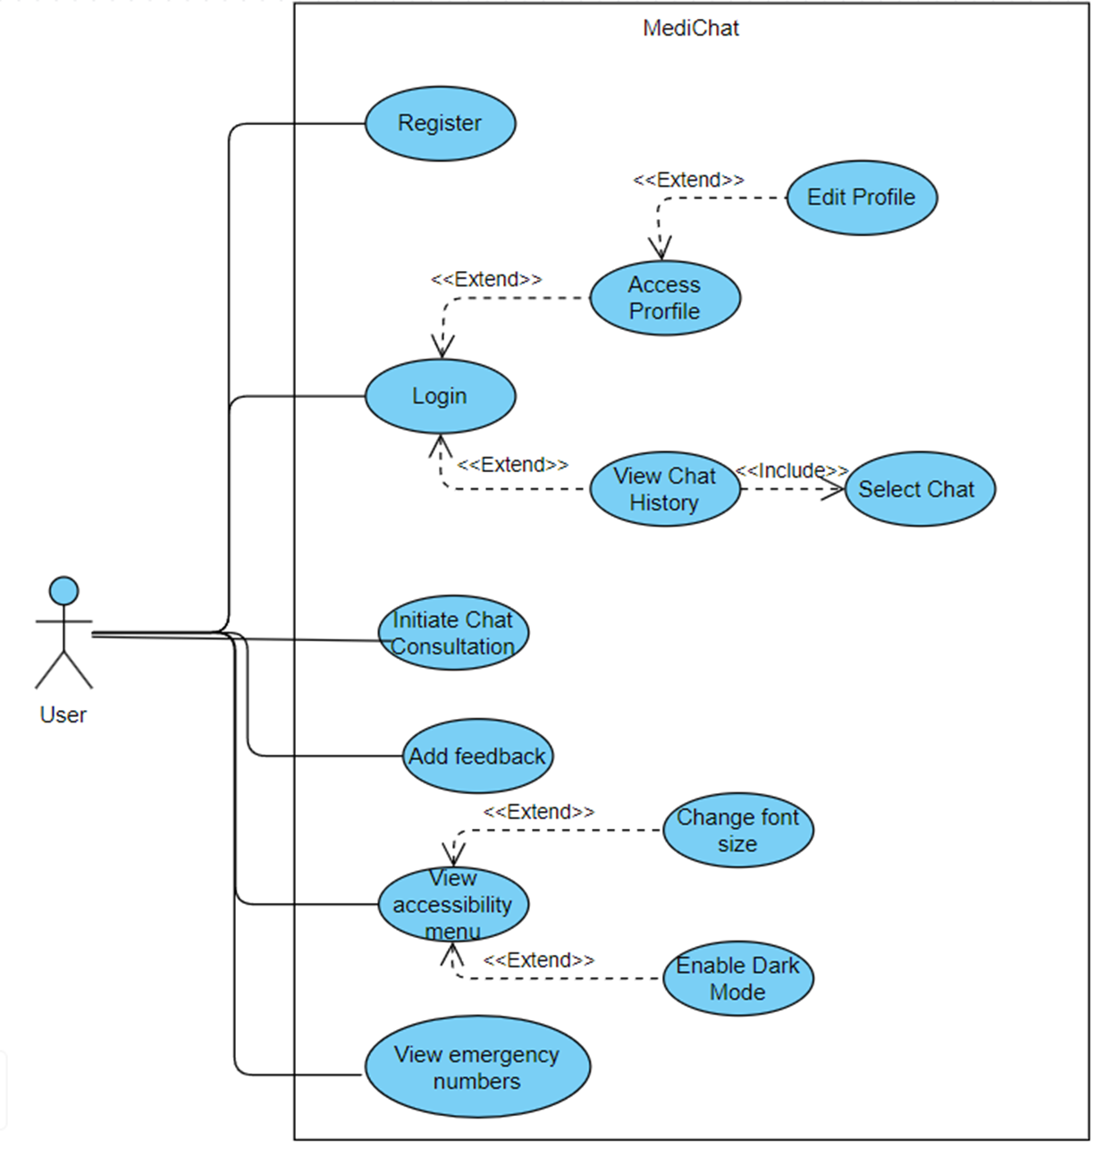
Class Diagram
Notes:
And this is the class diagram with all the use cases of our website, the user can login / register, initiate a chat, add feedback and interact with the accessibility menu.

Slide 17
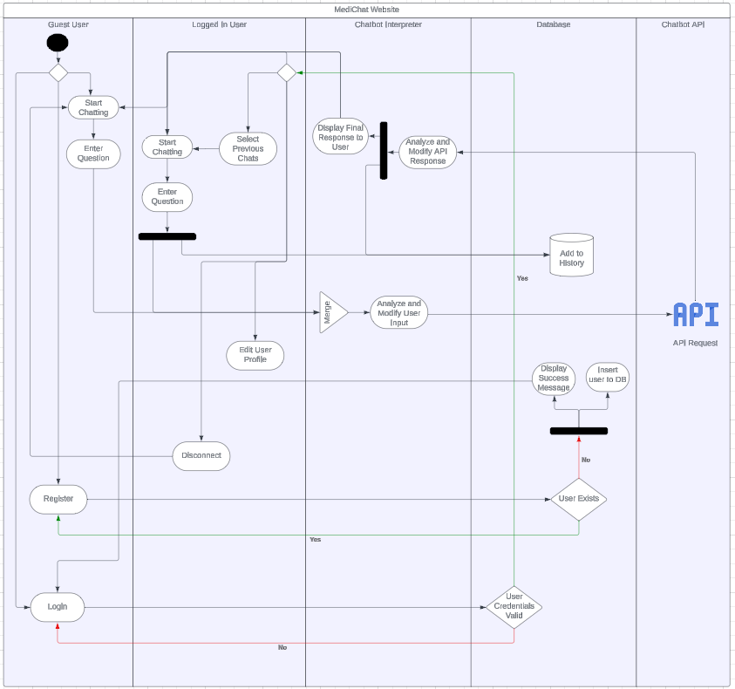
Activity Diagram
Notes:
And this is an activity diagram that shows the flow of the interaction between the user and our website, there are several options and flows for a user

Slide 18
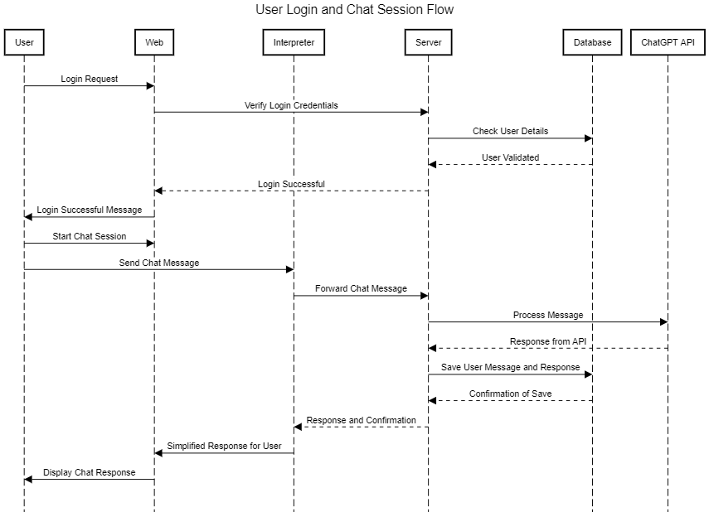
Sequence
Diagram
Notes:
A sequence diagram of a user login and starting a chat session in our website, explain abit.

Slide 19
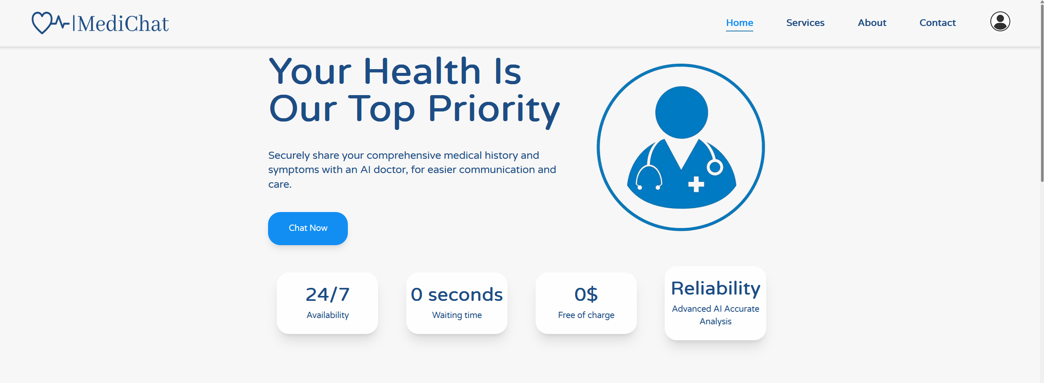
Main Screen
Notes:
Some GUI

Slide 20
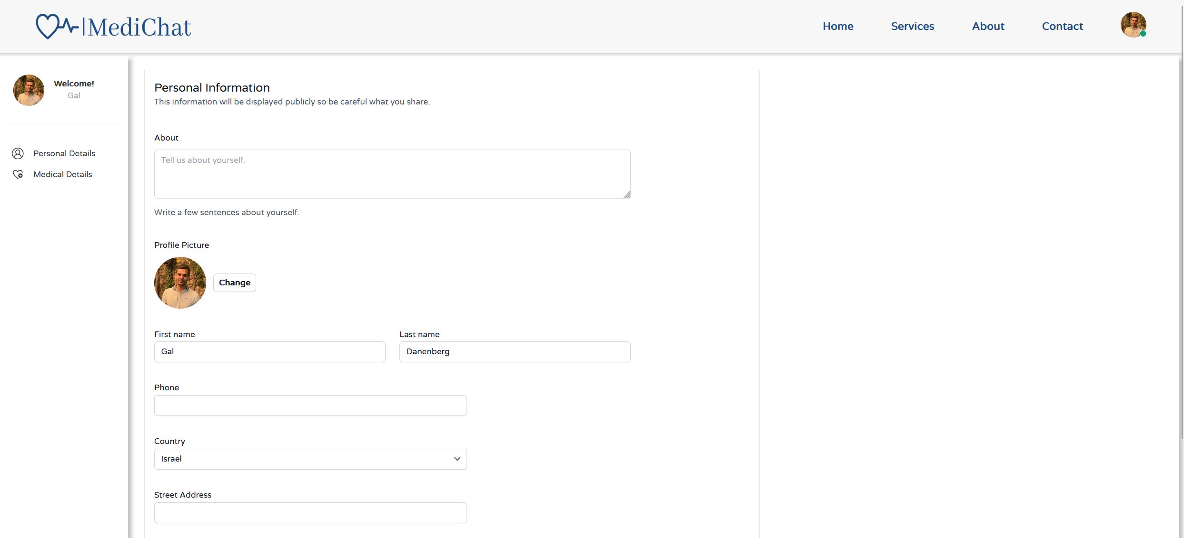
Profile Page - Personal

Slide 21
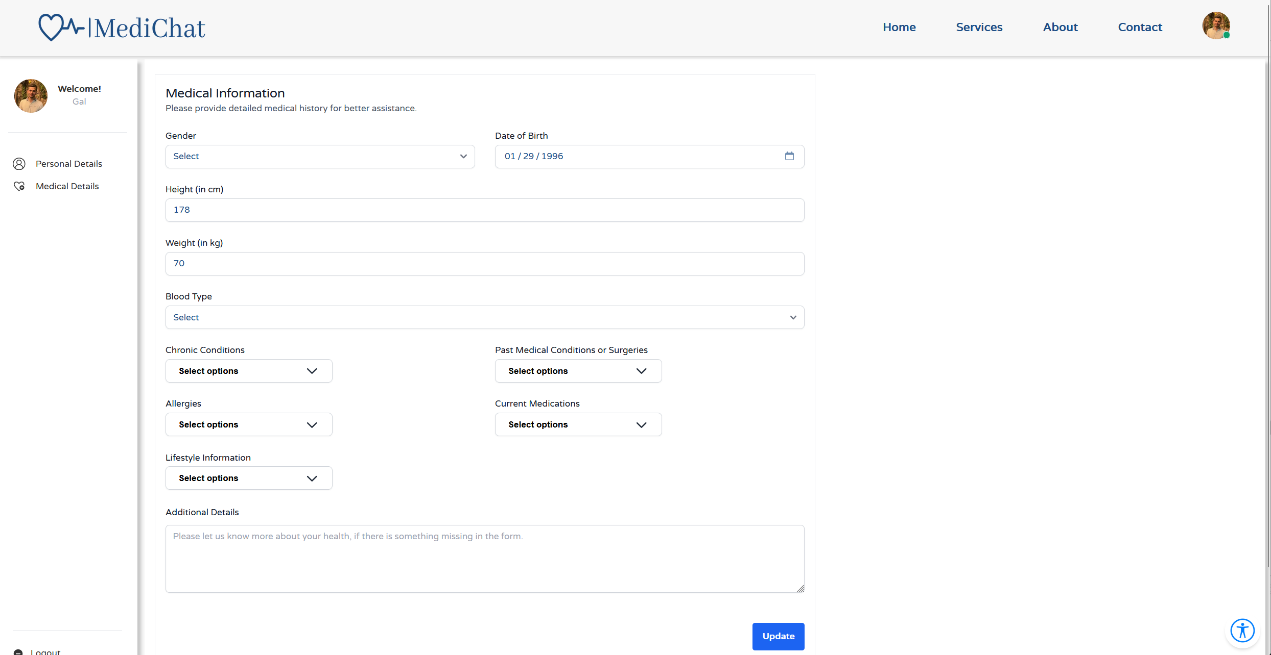
Profile Page - Medical

Slide 22
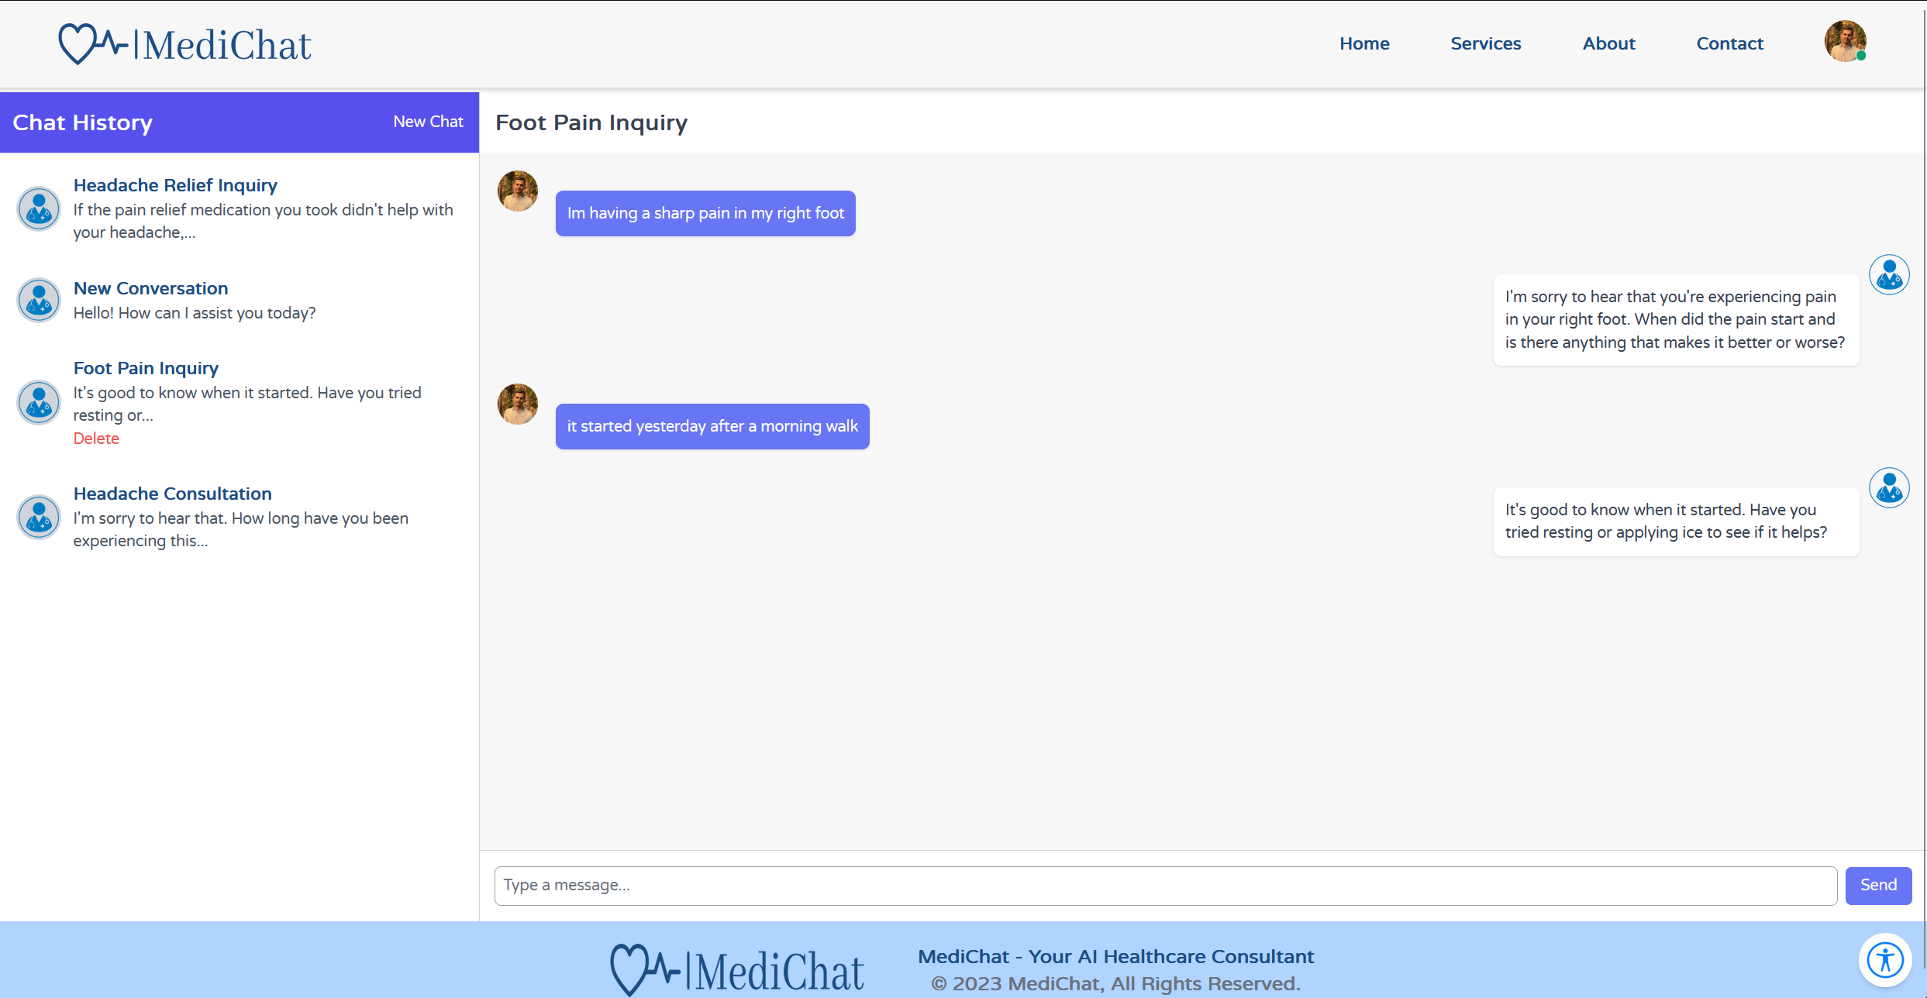
Chat window

Slide 23
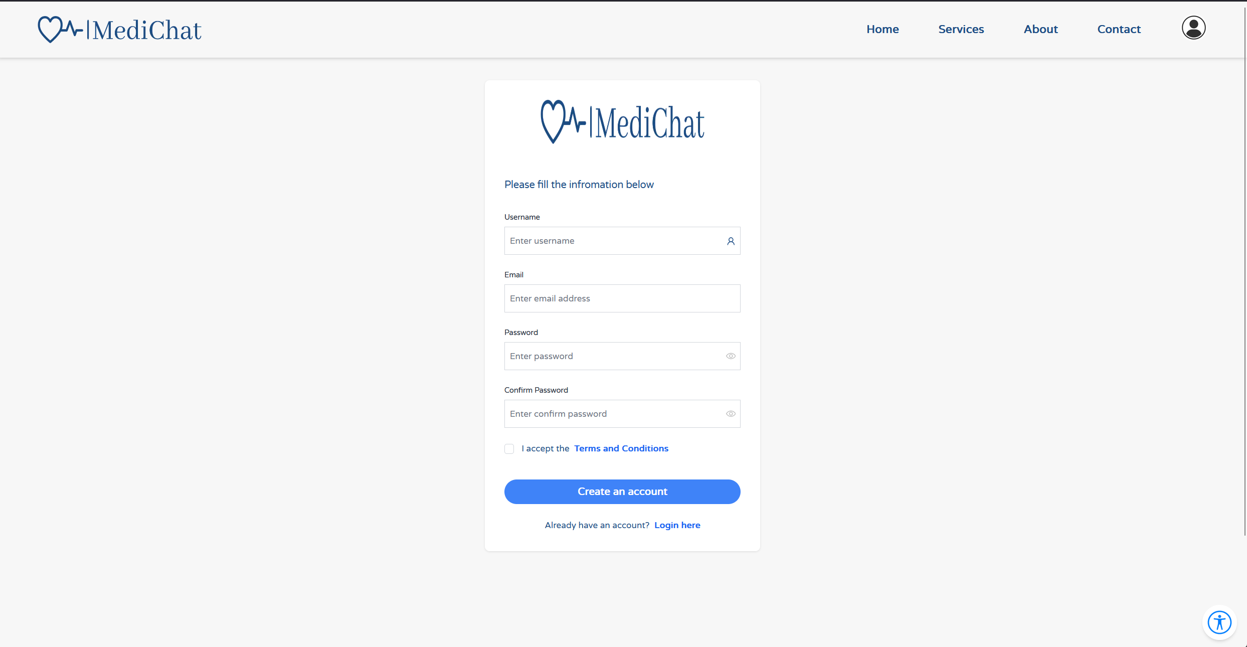
Registration

Slide 24
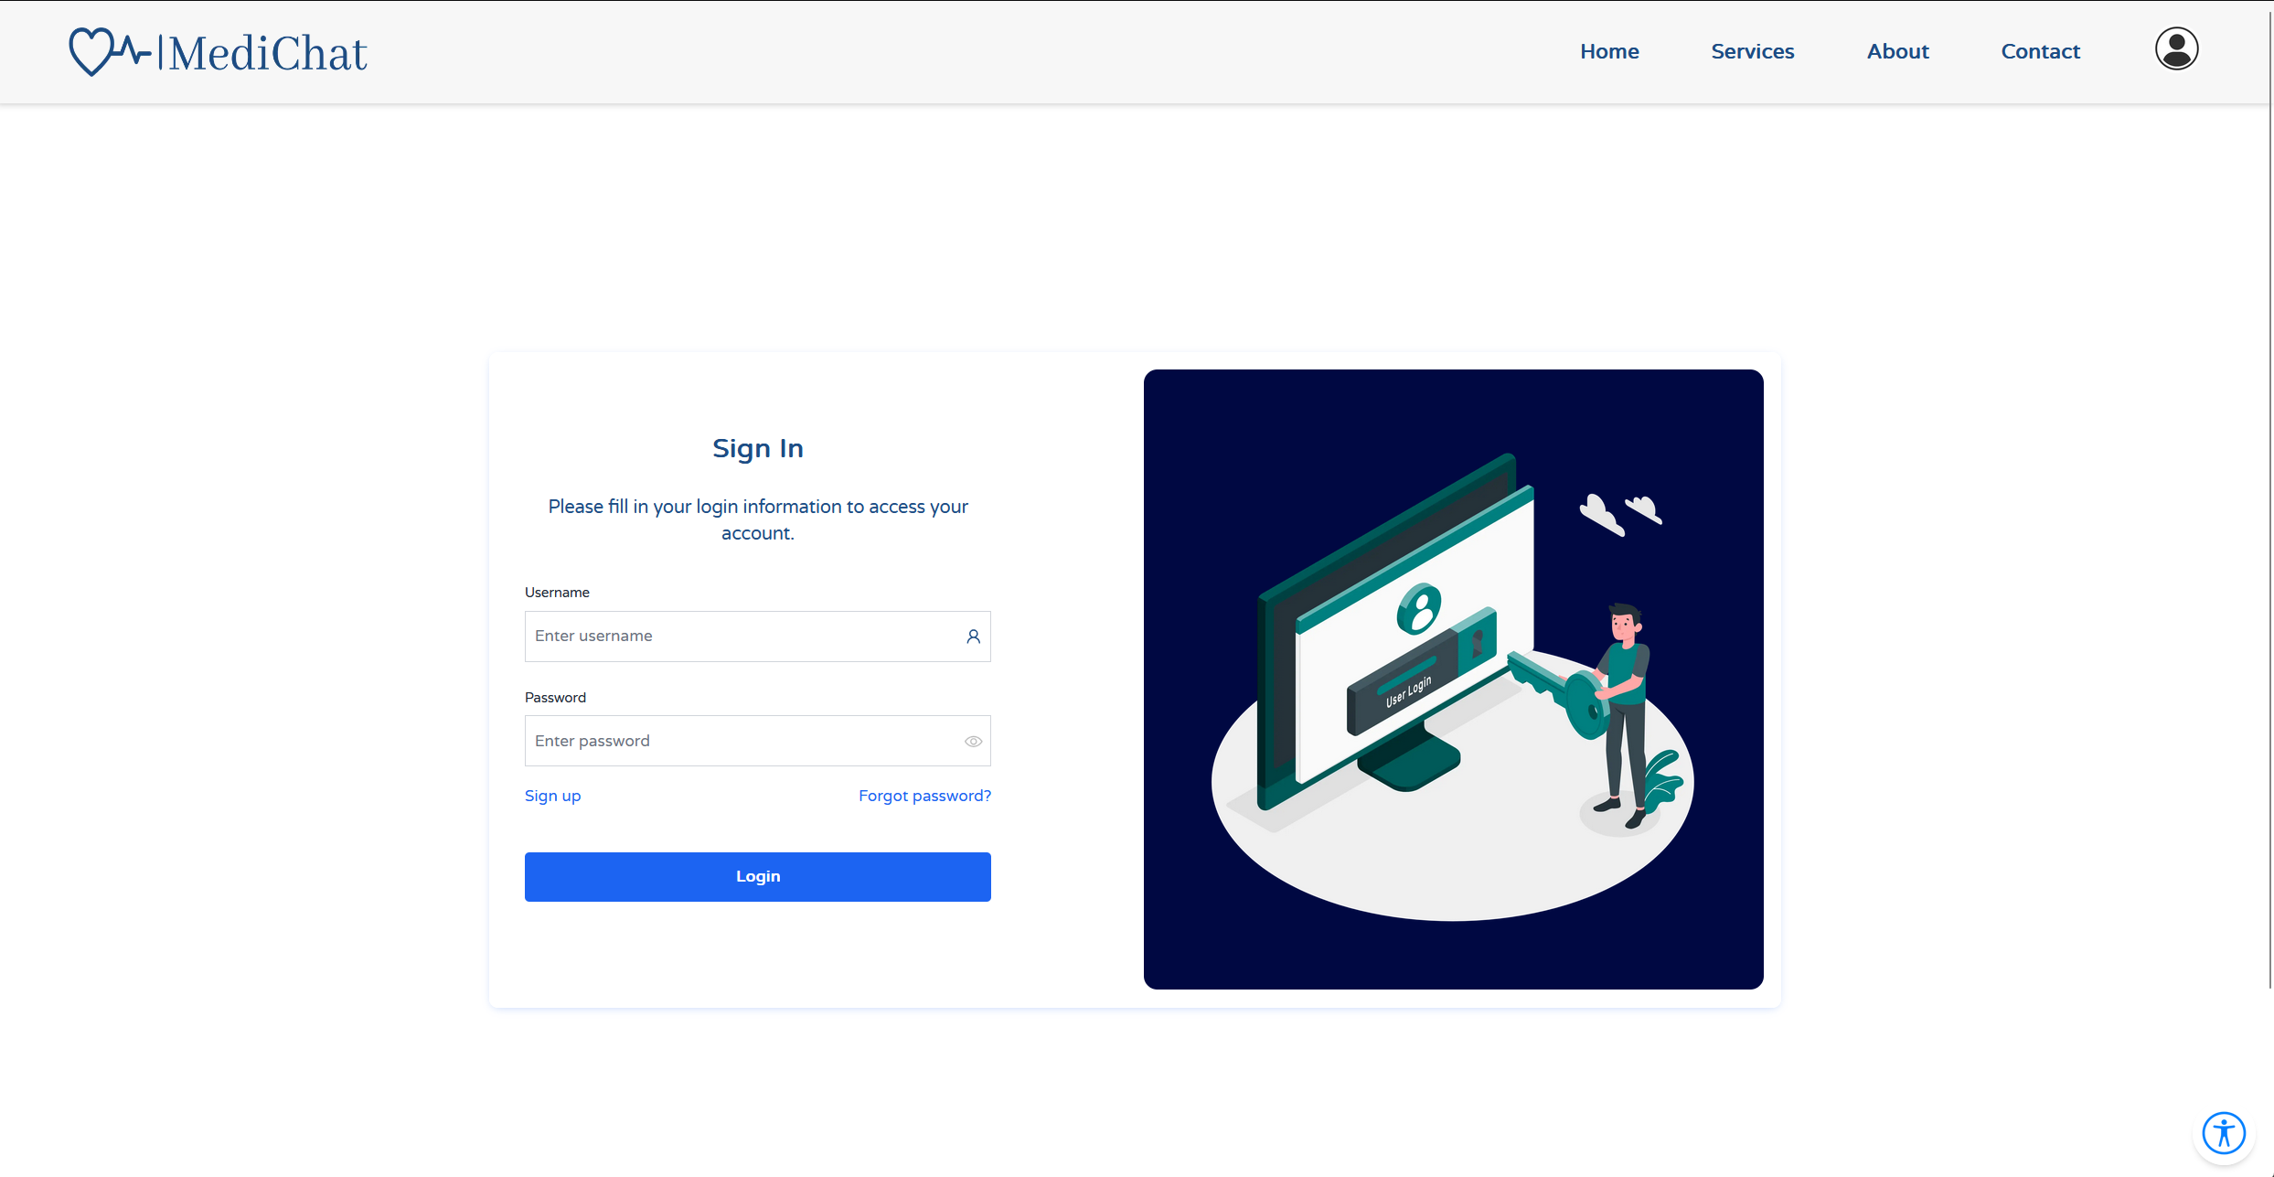
Login window

Slide 25


Verification And Testing
Our testing strategy will be divided into two distinct components:
- Frontend Testing
- Backend\API Testing

Slide 26


Git branching
Staging branch
Production branch
This branch is used to develop new features and bug fixes.
This branch contains the live code that is deployed to users.
Notes:
We used git for our version control we have two main branches, staging branch is for our testing and development before deploying updates to our production branch to ensure our main website is never broken and tested before any changes to it.

Slide 27

FrontEnd Testing
For the frontend testing of our application, we have chosen Playwright, a testing tool known for its ease of use and robust testing capabilities. Playwright excels in running automated tests written in JavaScript, allowing us to simulate real user interactions on web pages.
Notes:
We tested our application using Playwright, which is a testing tool for both ui and api, we tested our ui with an interaction tool which tests all the functionality of our website UI, and for our api we tested the responses and expected results of our requests.

Slide 28

BackEnd Testing
On the backend, we will also use Playwright’s framework to ensure the reliability and functionality of our APIs. Playwright is favored for its versatile and straightforward approach to both simple and complex test cases.

Slide 29
Thank You!

